Slide 1
Property List
By: David Zefanya Malau

Slide 2
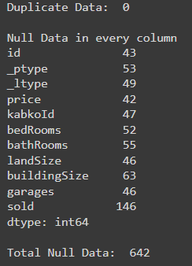
NULL DATA
There are no duplicate data from the output, but there are many null data in every each column. Total Null Data: 642

Slide 3
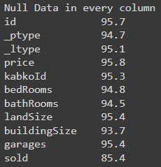
USAGE PERCENTAGE
The usage percentage of all data is in the picture on the left side.

Slide 4
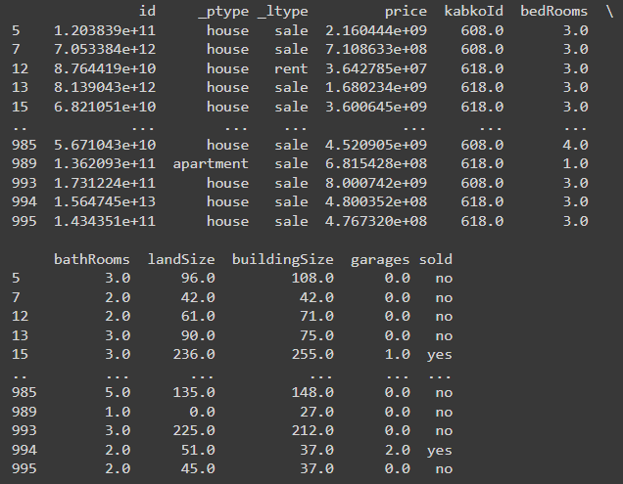
CLEAN DATA
After we clear data, the null data from each column is 0

Slide 5
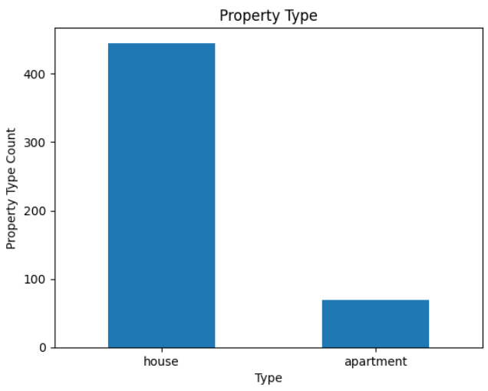
PROPERTY LIST
This is summary bar chart of propery list data, we can see from the left side

Slide 6
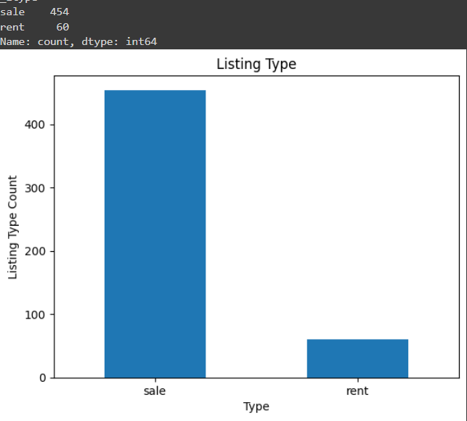
LISTING TYPE
This is summary bar chart of listing type data, we can see from the left side

Slide 7

PRICE
This is summary of price data, we can see from the left side.

Slide 8
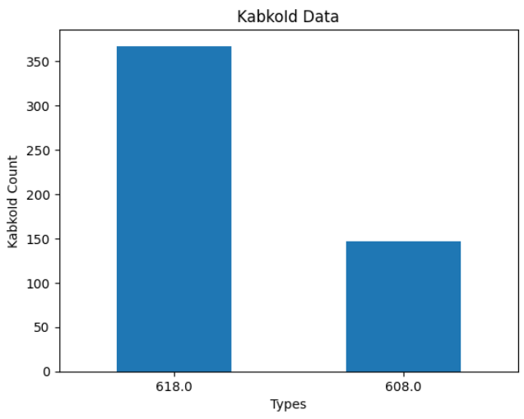
KABKOLD DATA
This is summary bar chart of kabkold data, we can see from the left side.

Slide 9
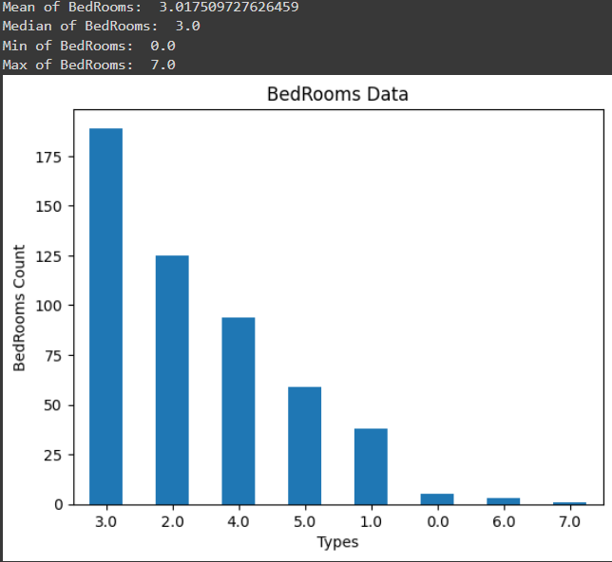
BEDROOM
This is summary bar chart of bedroom data, we can see from the left side. Mean: 3, Median: 3, Min: 0, Max: 7

Slide 10
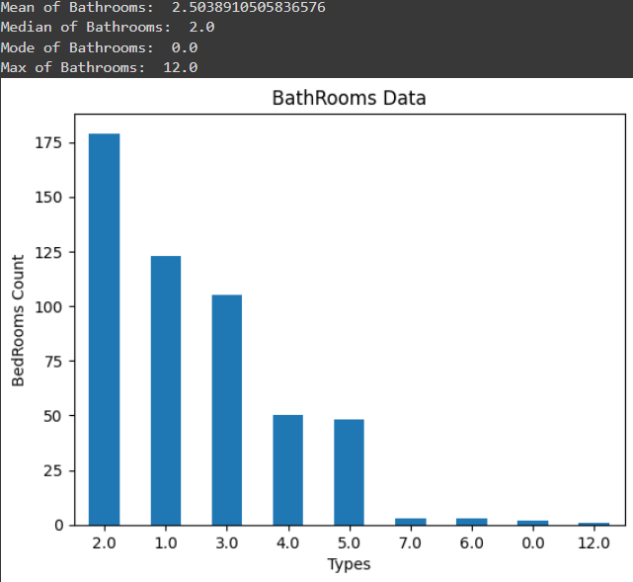
BATHROOM
This is summary bar chart of bathroom data, we can see from the left side. Mean: 2.5, Median: 2, Min: 0, Max: 12

Slide 11

BUILDING SIZE
This is summar bar chart of bedroom data, we can see from the left side. Mean: 147.5, Median: 77, Min: 0, Max: 8190

Slide 12
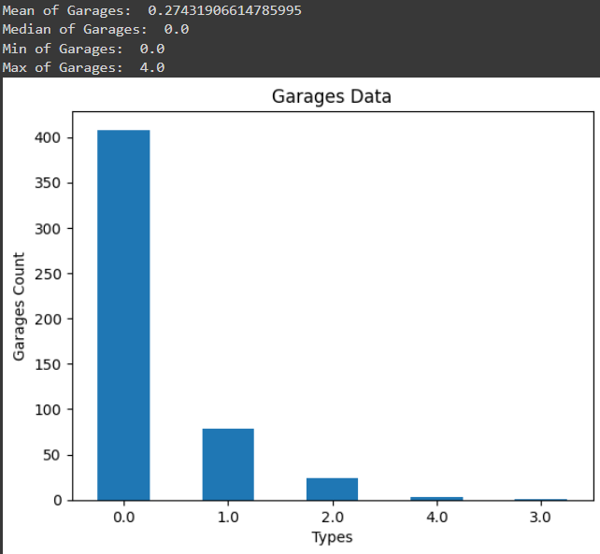
GARAGES
This is summary bar chart of garages data, we can see from the left side. Mean: 0.2, Median: 0, Min: 0, Max: 4

Slide 13
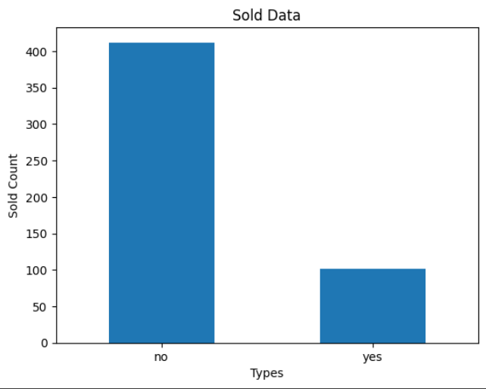
SOLD
This is summary bar chart of sold data, we can see from the left side.

Slide 14
THANK YOU!

